Slide 1
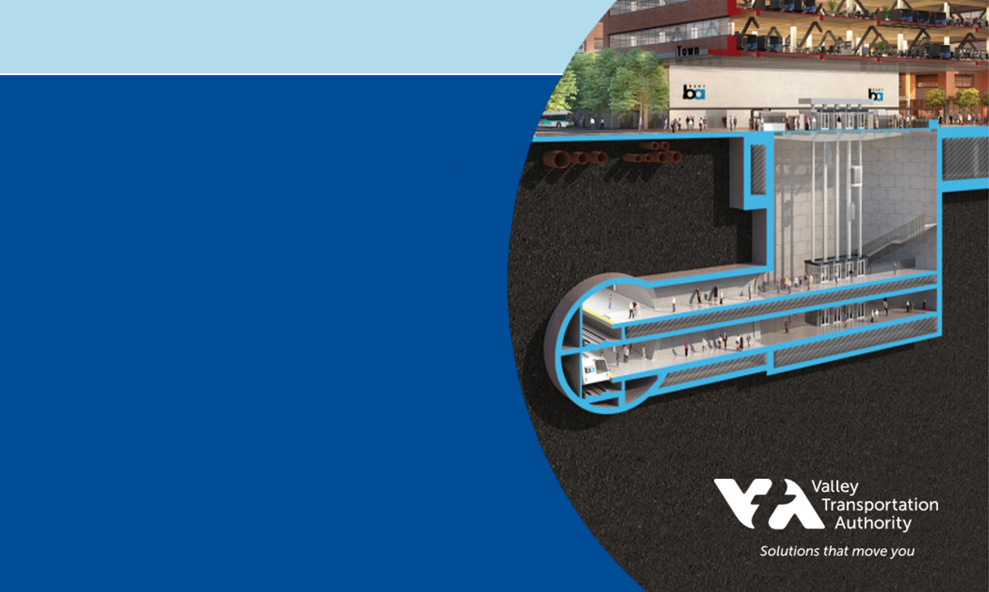

Welcome to Meet the Primes
BART Silicon Valley Phase II
Tunnels & Trackwork
and Rail Systems
September 22, 2021

Slide 2
VTA’s BART Silicon Valley Phase II Extension
Takis Salpeas, VTA
Chief BART Delivery Officer
Meet the Primes
September 22, 2021

Slide 3
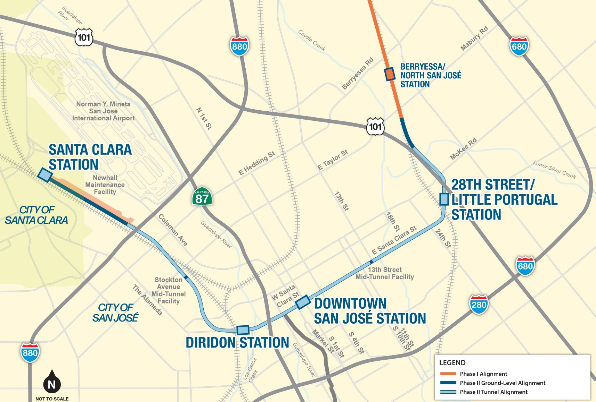
Project Overview
6-Mile Extension:
  1.5-mile single-bore stacked
  3.5-mile single-bore side-by-side
  1-mile at-grade
4 Stations:
  3 underground
  1 at-grade
2 Mid-Tunnel Ventilation/Emergency Egress Facilities
Newhall Yard Maintenance Facility
BART vehicles
Notes:
Bernice

Slide 4








VTA & BART Partnership
Santa Clara County is not part of the BART district. ​ A Comprehensive Agreement and an Operations and Maintenance Agreement provide a framework for the partnership.​
Santa Clara Valley Transportation Authority (VTA) Responsibilities
Bay Area Rapid Transit (BART) Responsibilities
Pay all costs associated with the extension
Contracting/Procurement
Construct to applicable BART/industry standards, codes, and regulations
Retain ownership of infrastructure
Technical assistance
Operations
Maintenance
Service Planning
An integrated VTA and BART team, the Rail and System Organization (RSO) has been established and is responsible for developing project specific requirements defining the applicable BART, federal, state, and local industry standard.

Slide 5
Funding Plan
Local, regional and state funding:
2000 Measure A Sales Tax
2016 Measure B Sales Tax
Regional Measure 3
State Transit & Intercity Rail Capital Program
Public-Private-Partnership
Google
Federal Transit Administration (FTA) - Expedited Project Delivery (EPD)
25% of Project Cost

Slide 6
Contracting Plan
Contract No. ​ | Title ​ | Delivery Method​ | General Scope*​
1​ | Systems ​ Approx. $500M | Design-Build (DB)​ | All rail system elements​
2​ | Tunnel & Trackwork​ Approx. $2,300M​ | Progressive Design-Build (PDB)​ | Tunnel & trackwork​ Mid-tunnel facilities​ Demolition, site prep and support of excavation for underground stations​ Adits ​ Utility relocations as required ​
3​ | Newhall Yard & Santa Clara Station​ Approx. $500M​ | Design-Build (DB)​ | Yard & Maintenance Facility​ Line & track ​ Santa Clara Station​ Parking garage​ Utility relocations as required ​
4​ | Stations​ Approx. $700M​ ​ | Design-Build (DB)​ | 28th Street/Little Portugal, Downtown and Diridon stations​ Parking Garage at 28th Street/Little Portugal Station​ Streetscape and final site work​
*Final scope elements under evaluation

Slide 7
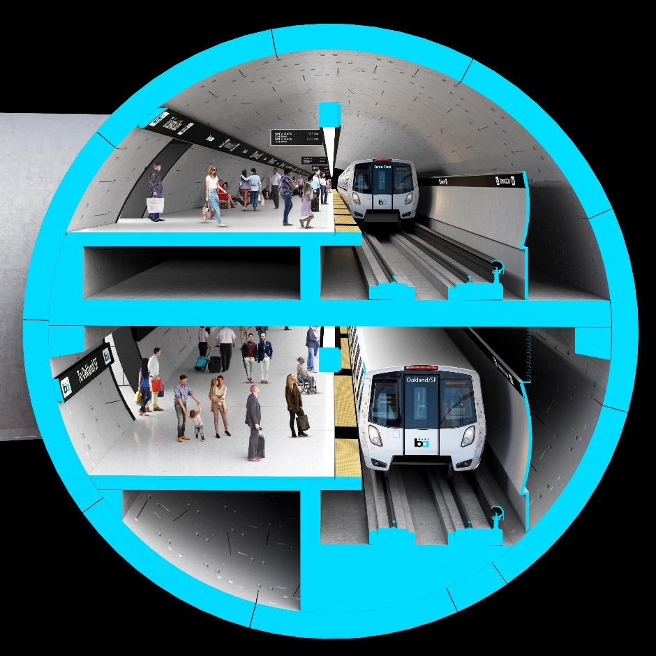
Ongoing/Upcoming Procurements
Contract Package 3 – Newhall Yard/Santa Clara Station
Request for Qualifications issued on 9/13/21
Statement of Qualifications due 11/13/21
Contract Package 4 – Stations
Statement of Qualifications due 9/23/21
Construction Management Services
RFP: Winter 2021/2022
Conceptual Rendering – Subject to Change

Slide 8
Framework to Completion
 | 2020 | 2021 | 2022 | 2023 | 2024 | 2025 | 2026 | 2027 | 2028 | 2029 | 2030
Systems
Tunnel & Trackwork
Newhall Yard & Santa Clara Station
Stations
BART System Testing/ Rail Acceptance/ CPUC Certification
Engineering & Procurement
Final Design & Construction
Engineering & Procurement
Final Design & Construction
Engineering & Procurement
Final Design & Construction
Engineering & Procurement
Final Design & Construction
September 2021
Substantial
Completion
Legend
RFIF
RFQ
RFP
NTP
*Subject to change based on RFIF/industry feedback
Notes:
3 minutes for BMA

Slide 9
Questions

Slide 10
Meet the Primes
BSV Phase II
Tunnels & Trackwork
and Rail Systems
September 22, 2021

