Slide 1

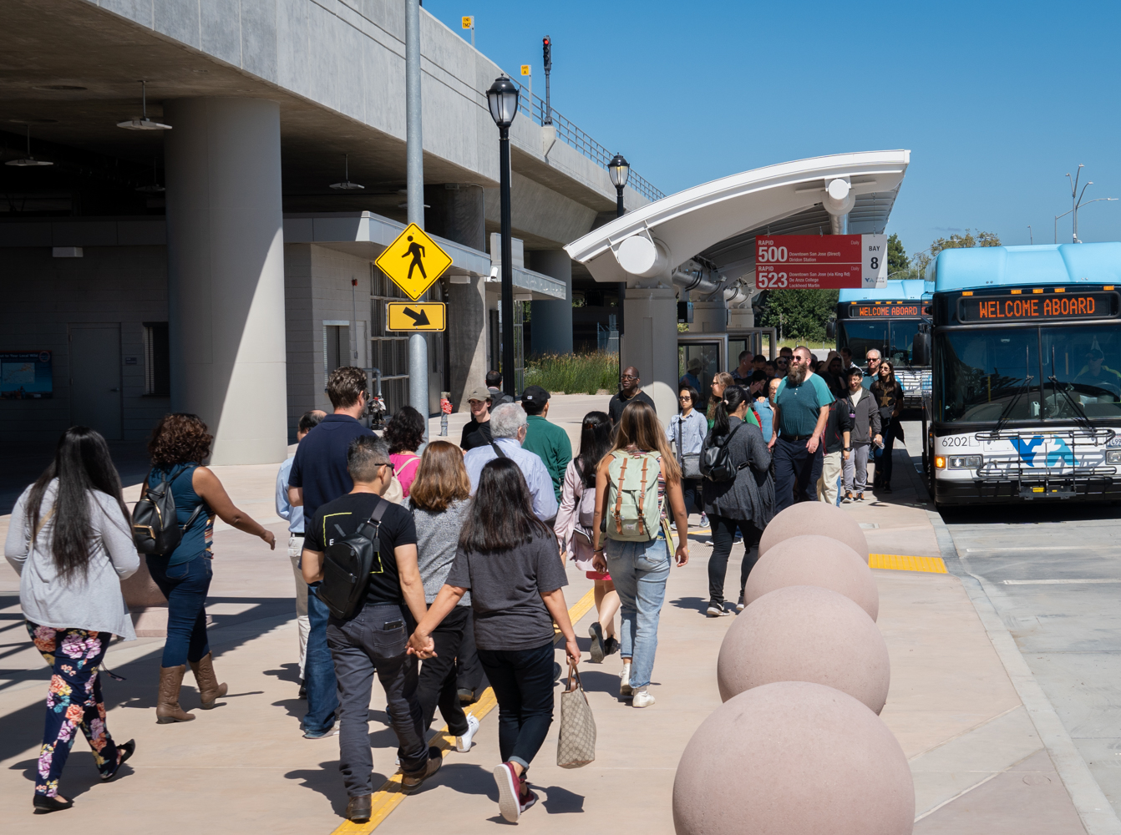
Proposed Biennial Budget
Fiscal Years 2024 & 2025
VTA Advisory Committees
May 2023

Slide 2

VTA Budgeted Funds
VTA Transit (Operations & Capital)
Congestion Management Program
Silicon Valley Express Lanes Program
Transit-Oriented Communities Program
VTP Highway Improvement Program
2008 Measure B - BART Operating Sales Tax Program
2000 Measure A Transit Improvement Program
2016 Measure B Program

Slide 3
Proposed Budget Summary
(in Thousands)
Fund¹ | Fiscal Year 2024 | Fiscal Year 2025
VTA Transit-Operating | $ 601,535 | $ 623,577
VTA Transit-Capital | TBD | ---²
Congestion Management Program – Operating | 7,187 | 7,073
Silicon Valley Express Lanes Program – Operating | 10,329 | 10,759
Transit-Oriented Communities Program – Operating | 1,060 | 1,000
Transit-Oriented Communities Program – Capital | 14,159 | ---²
VTP Highway Program – Capital | 417,383 | ---²
2000 Measure A Transit Improvement Program – Operating | 147,526 | 150,090
2000 Measure A Transit Improvement Program – Capital | 2,415,787 | ---²
2008 Measure B – BART Operating Sales Tax – Operating | 109,471 | 106,571
2008 Measure B – BART Operating Sales Tax – Capital | 777 | ---²
2016 Measure B Program | 907,790 | ---²
¹ Includes transfers between funds.
² Total appropriation for FY 2024 and FY 2025 reflected in FY 2024.

Slide 4
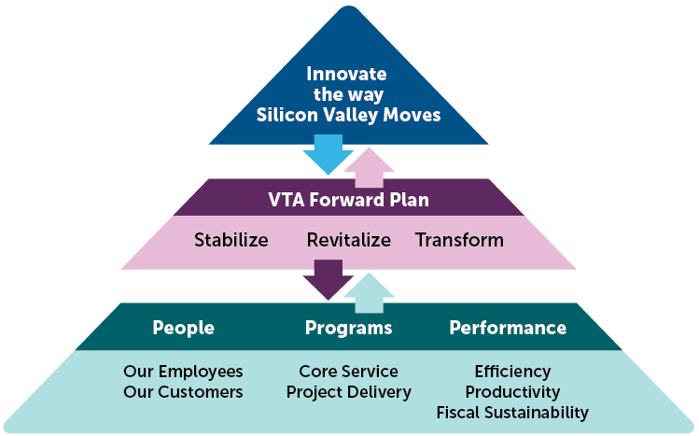
Transit Operation Focus

Slide 5
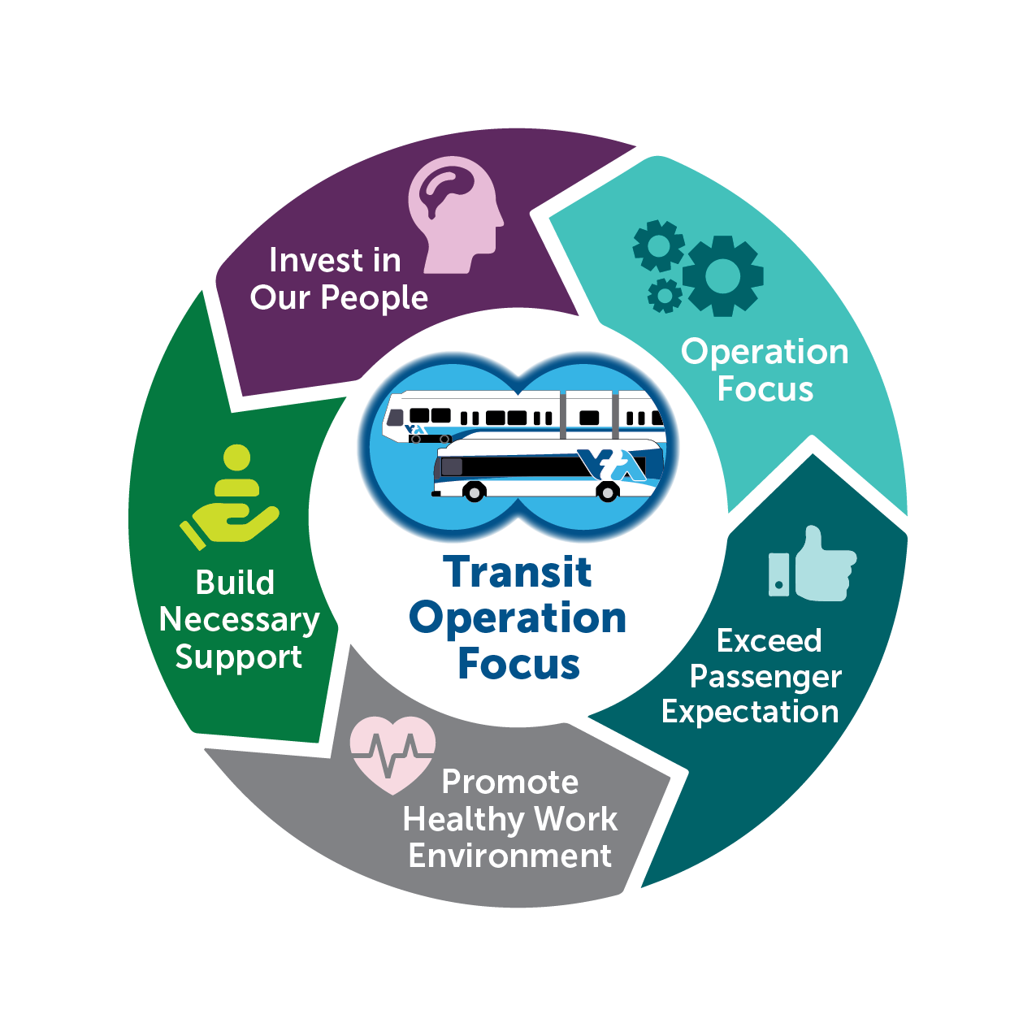
Transit Operation Focus

Slide 6
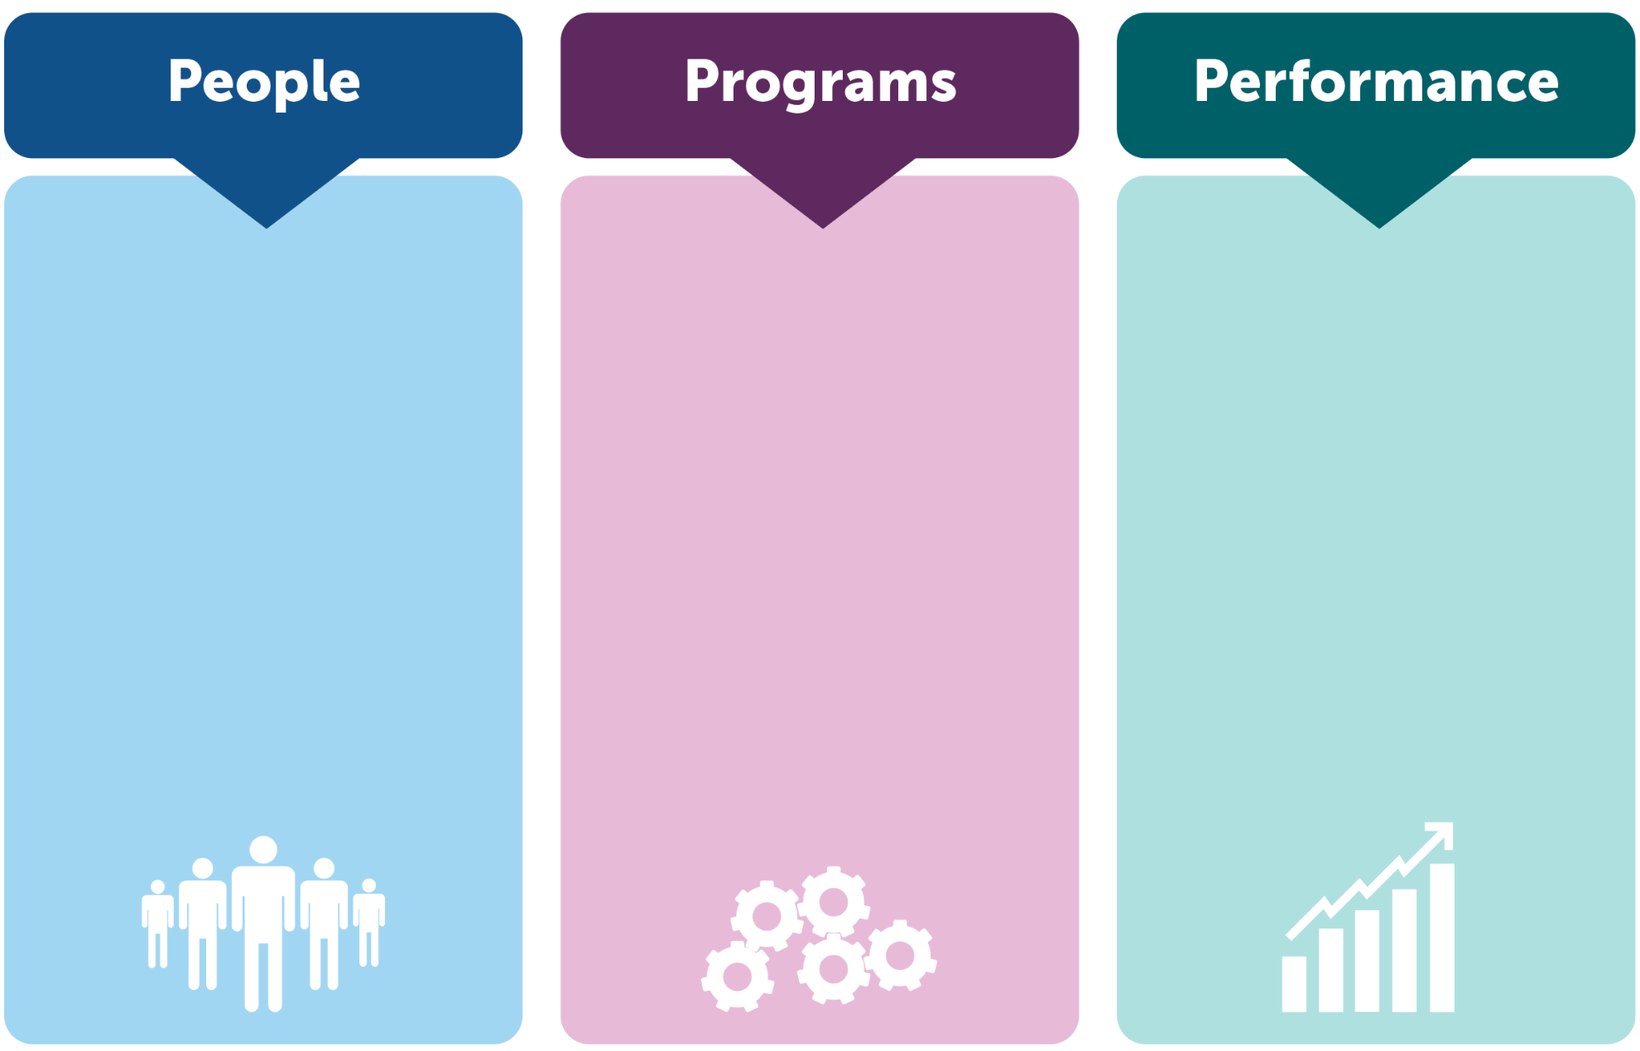
Transit Operation Focus
Training
Working environment
Hiring, retention
Recognition
Passenger focus
Service reliability
Process improvements
Facility improvements
Platform/Bus stop improvements
Ridership
metrics
System reliability
Equity
Accessibility

Slide 7
Transit Proposed Budget
Category ($$ in thousands) | FY22 Actual | FY23 Projected | FY24 Proposed | FY25 Proposed
Sales Tax Based Revenues | 473,449 | 507,673 | 524,023 | 547,403
Other Revenues | 204,369 | 43,528 | 53,063 | 49,801
Fares | 21,921 | 26,785 | 25,899 | 26,395
Total Operating Revenue | 699,739 | 577,986 | 602,985 | 623,599
Labor | 353,484 | 378,413 | 404,499 | 425,484
Non-Labor | 74,605 | 84,259 | 96,088 | 93,857
Partnerships | 39,447 | 28,062 | 37,152 | 40,504
Debt Service | 20,903 | 20,906 | 20,796 | 20,732
Total Operating Expense | 488,439 | 511,640 | 558,535 | 580,577
Transfer to Capital | 40,000 | 40,000 | 40,000 | 40,000
Contingency | 0 | 2,726 | 3,000 | 3,000
Total Transfer & Contingency | 40,000 | 42,726 | 43,000 | 43,000
Total Operating/Transfer & Contingency | 528,439 | 554,366 | 601,535 | 623,577
Operating Surplus | 171,300 | 23,620 | 1,450 | 22
Note: Totals may not be precise due to independent rounding

Slide 8
Transit Fund Revenues
Revenue Source (in millions) | FY23 Projected | FY24 Proposed | FY25 Proposed
Fares | $26.79 | $25.90 | $26.40
1976 Half Cent Sales Tax | $274.25 | $279.94 | $290.22
Transportation Development Act (TDA) | $128.01 | $124.77 | $129.71
STA | $30.50 | $45.72 | $46.98
2000 Measure A Sales Tax-Operating Assistance | $55.77 | $58.09 | $60.22
2016 Measure B - Transit OPS | $19.15 | $15.50 | $20.27
Other | $43.53 | $53.06 | $49.80
Total | $577.99 | $602.98 | $623.60
Note: Totals and percentages may not be precise due to independent rounding

Slide 9
Transit – Ridership Projection
145%

Slide 10
FY19 – FY23 Ridership Trend (Actuals)
FY 19

Slide 11
Transit Proposed Budget
Category ($$ in thousands) | FY22 Actual | FY23 Projected | FY24 Proposed | FY25 Proposed
Labor | 353,484 | 378,413 | 404,499 | 425,484
Non-Labor | 74,605 | 84,259 | 96,088 | 93,857
Partnerships | 39,447 | 28,062 | 37,152 | 40,504
Debt Service | 20,903 | 20,906 | 20,796 | 20,732
Total Operating Expense | 488,439 | 511,640 | 558,535 | 580,577
Transfer to Capital | 40,000 | 40,000 | 40,000 | 40,000
Contingency | 0 | 2,726 | 3,000 | 3,000
Total Transfer & Contingency | 40,000 | 42,726 | 43,000 | 43,000
Total Operating/Transfer & Contingency | 528,439 | 554,366 | 601,535 | 623,577
Note: Totals may not be precise due to independent rounding

Slide 12
Transit- Proposed Expense
By Expenditure Type (in millions) | FY23 Projected | FY24 Proposed | FY25 Proposed
Service Delivery | $462.67 | $500.59 | $519.34
Contracted Services | $27.48 | $36.34 | $39.37
Debt Service | $20.91 | $20.80 | $20.73
Other | $3.30 | $3.81 | $4.13
Transfer to Capital Reserve | $40.00 | $40.00 | $40.00
Total | $554.37 | $601.54 | $623.58
Note: Totals and percentages may not be precise due to independent rounding

Slide 13
Service Delivery Expense Category
Service Delivery Breakdown (in millions) | FY24 | FY25
Wages & Benefits | $404.50 | $425.49
Reimbursements | ($43.48) | ($44.57)
Subtotal Labor Costs | $361.02 | $380.92
Materials & Supplies | $29.23 | $27.59
Security | $24.18 | $24.87
Fuel & Traction Power | $19.89 | $20.02
Other Operating Expense | $66.26 | $65.94
Total | $500.59 | $519.34
Note: Totals and percentages may not be precise due to independent rounding

Slide 14
Transit - Service Levels
  (In Thousands)
 | FY 2022 Actual | FY 2023 Projected | FY 2024 Proposed | FY 2025 Proposed
Service Miles
Bus | 16,450 | 17,209 | 18,547 | 18,964
Light Rail Train | 1,479 | 2,022 | 2,208 | 2,220
Total Service Miles | 17,929 | 19,231 | 20,755 | 21,184
% change |  | 7.3% | 7.9% | 2.1%
Service Hours
Bus | 1,222 | 1,369 | 1,475 | 1,508
Light Rail Train | 109 | 144 | 160 | 166
Total Service Hours | 1,331 | 1,513 | 1,635 | 1,674
% change |  | 13.7% | 8.1% | 2.4%
Note: Totals and percentages may not be precise due to independent rounding

Slide 15
Labor & Benefits
Key elements of budget
  Assumes current labor agreements
  Does not include potential impact of Classification & Compensation study
  Operators training budget at $2.0 million per year
Benefit Assumptions
($ in millions) | FY23 | FY24 | FY25
Pension Contribution | $55.00 | $54.51 | $55.95
OPEB Contribution | $6.29 | $4.44 | 4.44
Medical Insurance | $55.30 | $58.11 | $63.48
Total Positions
FY23¹ | FY24 | FY25
2,365 | 2,391 | 2,391
Vacancy Rate
FY23² | FY24 | FY25
13.9% | 8% | 8%
¹ Position as of 6/30/21
² Average vacancy rate

Slide 16
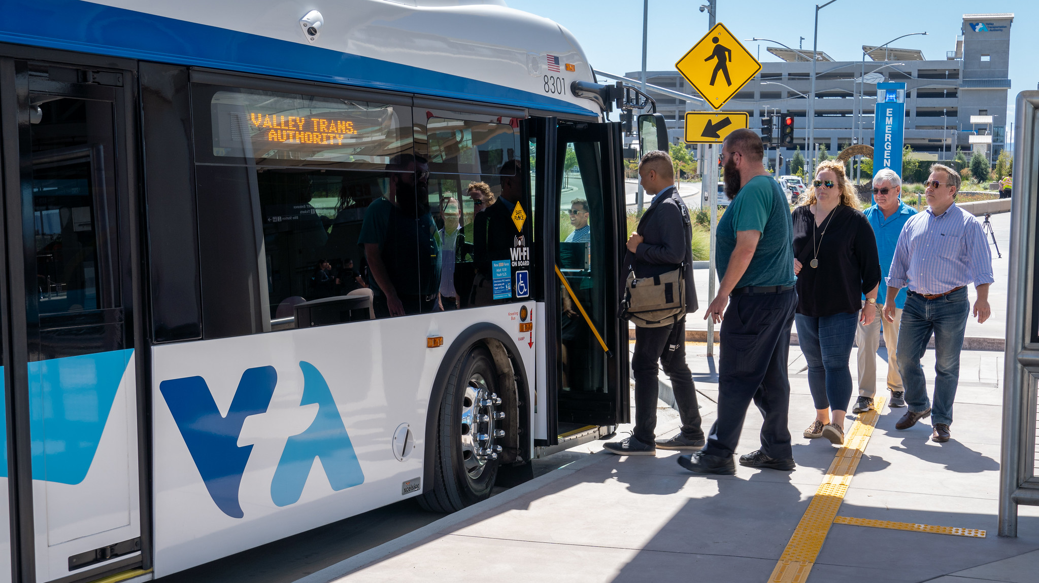
Budget Assumption Risks
Economic volatility
  Sales tax receipt growth
  Diesel fuel prices
  Utilities
  Inflation
Transit ridership
New initiatives

Slide 17
10-Year Projection
($$ in millions) | FY24 | FY25 | FY26 | FY27 | FY28 | FY29 | FY30 | FY31 | FY32 | FY33
Sales Tax Based Revenues | 524.02 | 547.40 | 557.32 | 576.00 | 593.60 | 610.16 | 626.52 | 643.32 | 660.56 | 678.26
Other Revenues | 53.06 | 49.80 | 46.59 | 28.01 | 26.19 | 26.63 | 26.93 | 27.24 | 27.55 | 27.87
Fares | 25.90 | 26.40 | 27.19 | 28.00 | 28.84 | 29.71 | 30.30 | 30.91 | 31.53 | 32.16
Total Operating Revenue | 602.98 | 623.60 | 631.10 | 632.01 | 648.64 | 666.49 | 683.75 | 701.46 | 719.64 | 738.29
Labor | 404.50 | 425.48 | 440.38 | 455.79 | 471.74 | 488.25 | 500.46 | 512.97 | 525.80 | 538.94
Non-Labor | 96.09 | 93.86 | 97.81 | 101.91 | 106.18 | 110.60 | 113.61 | 116.70 | 119.86 | 123.12
Partnerships | 37.15 | 40.50 | 41.92 | 43.39 | 44.91 | 46.48 | 47.64 | 48.83 | 50.05 | 51.30
Debt Service | 20.80 | 20.73 | 20.74 | 3.87 | 3.91 | - | - | - | - | -
Total Operating Expense | 558.54 | 580.58 | 600.84 | 604.97 | 626.74 | 645.34 | 661.71 | 678.50 | 695.71 | 713.36
Transfer to Capital/Capital Fund | 40.00 | 40.00 | 29.64 | 23.78 | 19.11 | 18.70 | 19.52 | 20.38 | 21.28 | 22.21
Transfer to Operating Reserve |  |  | 0.62 | 3.27 | 2.79 | 2.46 | 2.52 | 2.58 | 2.65 | 2.71
Contingency | 3.00 | 3.00 | - | - | - | - | - | - | - | -
Total Operating/Transfer & Contingency | 601.54 | 623.57 | 631.11 | 632.01 | 648.64 | 666.49 | 683.75 | 701.46 | 719.64 | 738.28
Operating Balance | 1.44 | 0 | 0 | 0 | 0 | 0 | 0 | 0 | 0 | 0
Note: Totals may not be precise due to independent rounding

Slide 18
VTA Transit Capital Budget Focus
Evaluating previously approved projects
Prioritize essential needs – repurpose some funds.
Capital focus
  Facility Improvements
  Critical Infrastructure
  Safety & Security
  Zero-emission Fleet / Infrastructure.
  Mandates

Slide 19
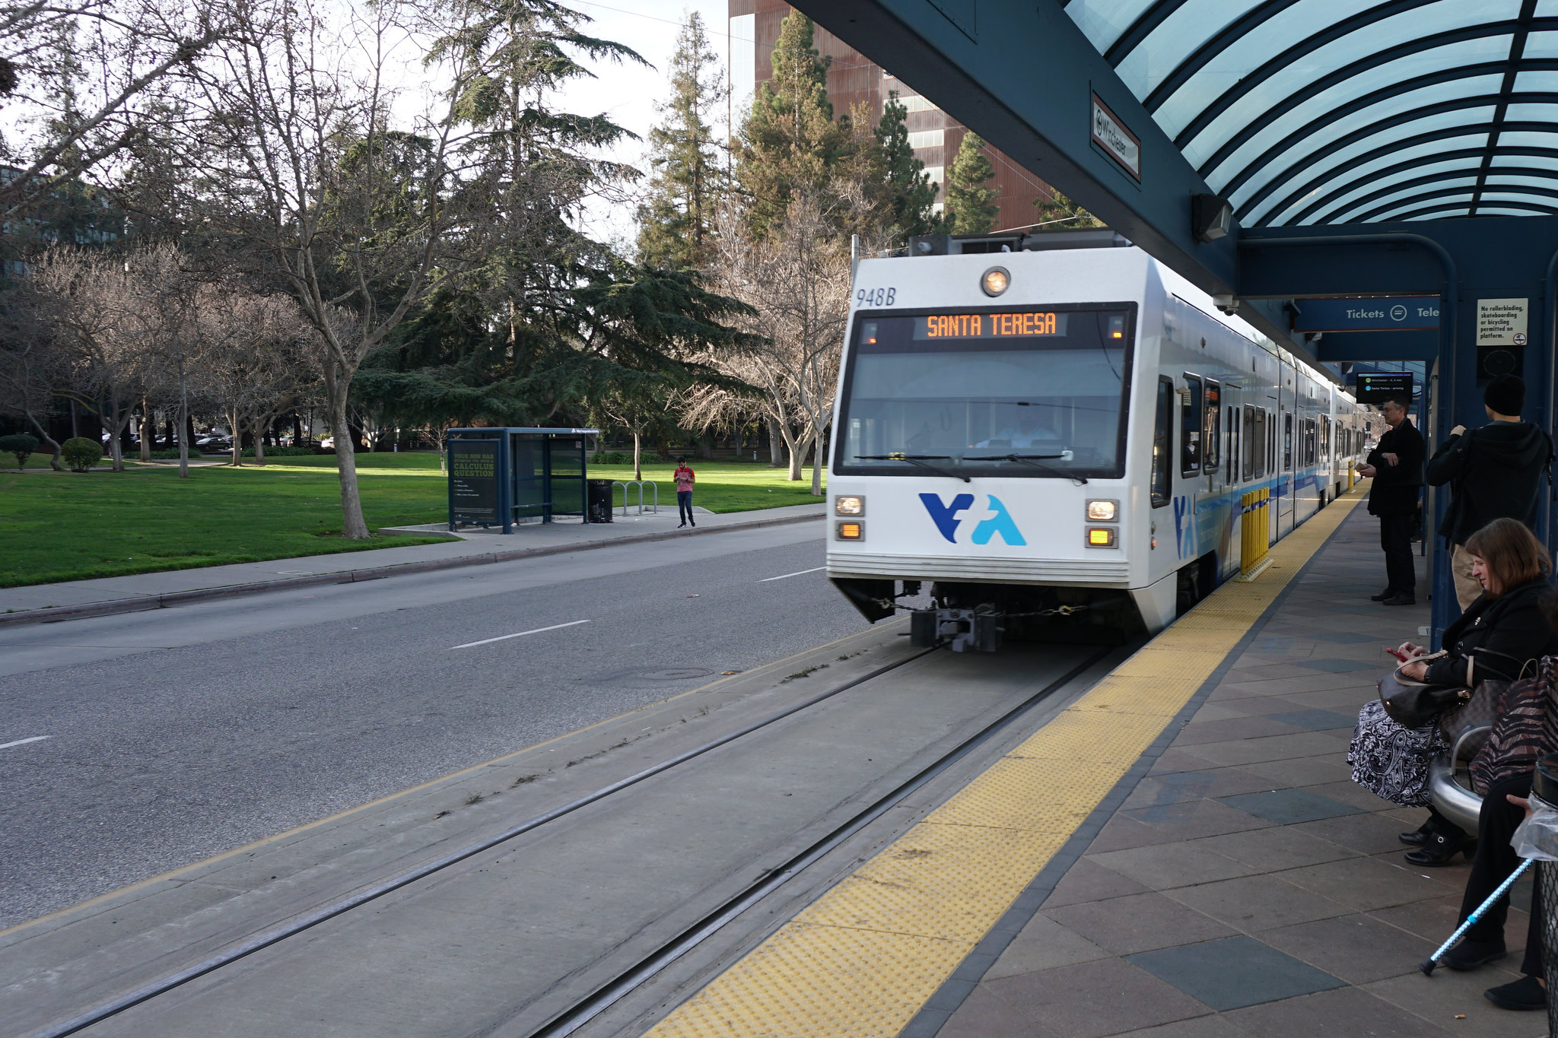
Policy Change Proposal
Create Separate Capital Fund
  Currently part of Debt Reduction Fund
  Prefer dedicated and separate fund
  Utilize $100 million of Debt Reduction Fund as seed
  Operating performance surplus will transfer to Capital Fund
  Will be the source of Capital Project funds going forward
Modify Operating Reserve Calculation
  Currently 15% of the following fiscal year’s Operating Budget
  This includes Capital Transfer as budgeted
  Propose to exclude Capital Transfer as part of Operating Reserve calculation

Slide 20
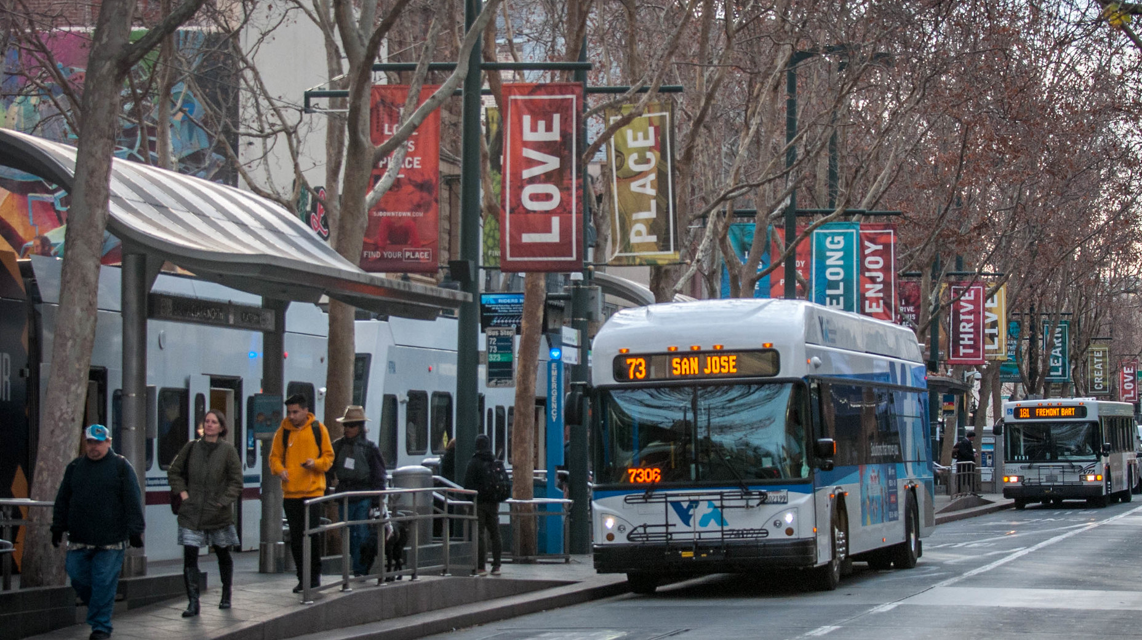
Other Programs / Funds

Slide 21
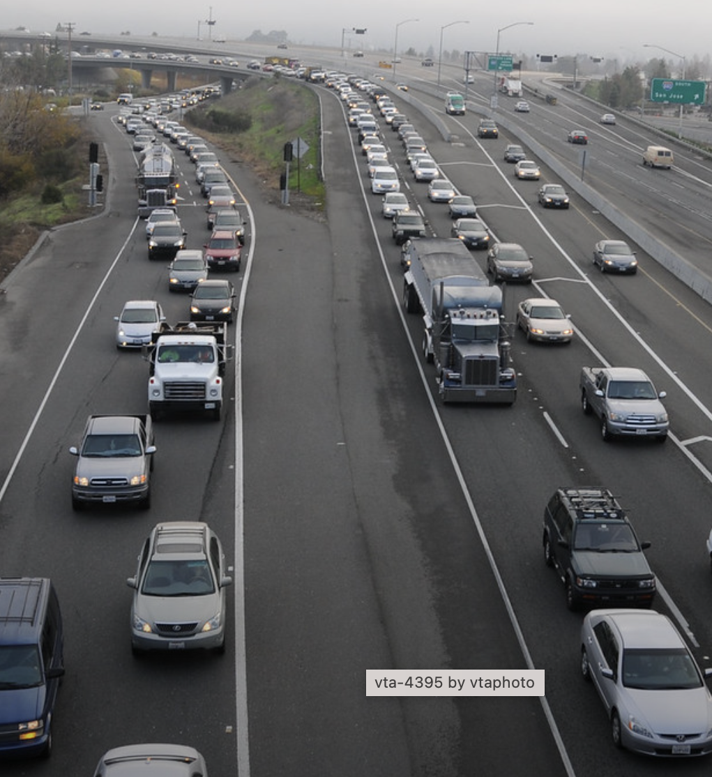
Congestion Management Program
Programming and Grants
Congestion Mgmt Program Conformance
Land Use and Transportation Integration
Plans, Studies, and Traffic Engineering
Proposed Budget
Category | FY24 (in millions) | FY25 (in millions)
Revenues | $6.26 | $6.71
Expenses | $7.19 | $7.07
Net Revenue/Expense | ($0.93) | ($0.37)
Note: Totals may not be precise due to independent rounding

Slide 22
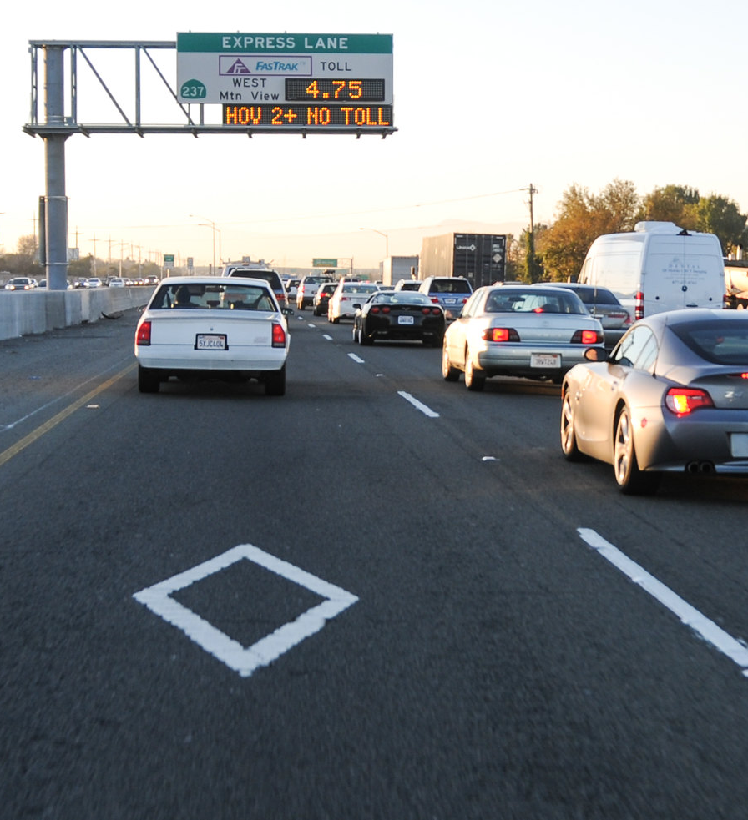
Silicon Valley Express Lanes Program
Reflects anticipated revenues and expenses for both the SR 237 Express Lanes and the US 101 Express Lanes
Proposed Budget
Category | FY24 (in millions) | FY25 (in millions)
Revenues | $12.12 | $12.63
Expenses | $10.33 | $10.76
Net Revenue/Expense | $1.79 | $1.87

Slide 23
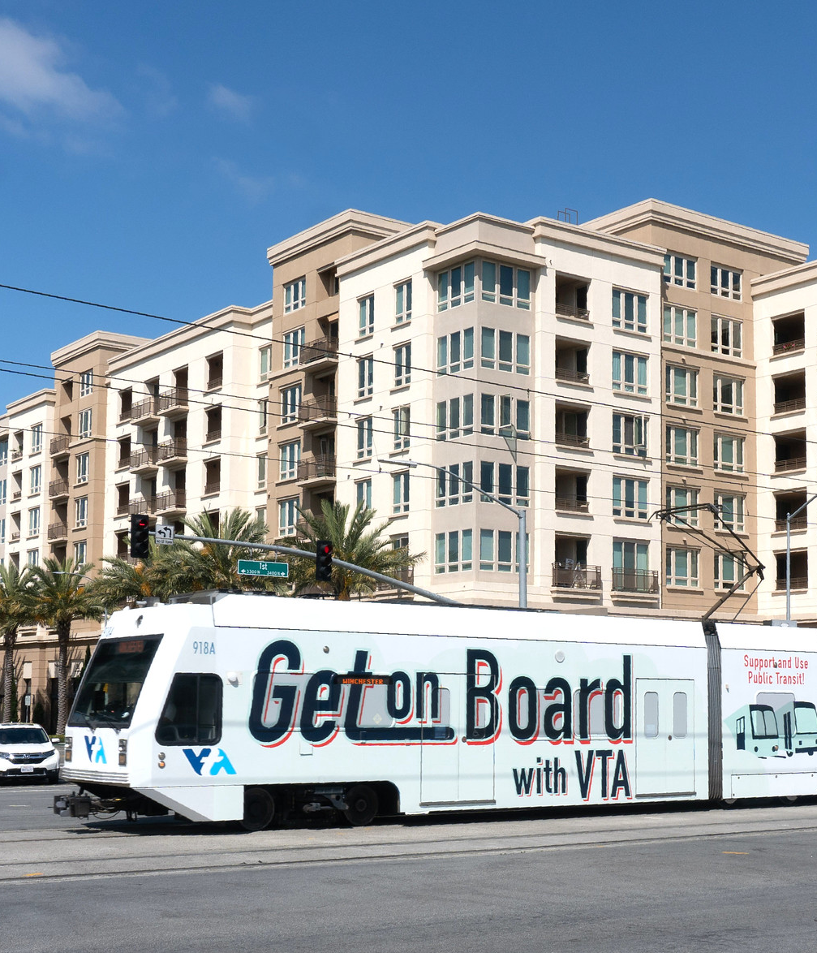
Transit-Oriented Development/Communities
Can we make this more appealing. Ie. Picture inbackground, etc..
Reflects continuation of efforts to create mixed-use, mixed-income Transit-Oriented Development, with higher proportion of affordable housing units and expanded focus on workforce housing
Proposed Budget
Type | FY24 (in millions) | FY25 (in millions)
Operating Budget:
Revenues | $2.69 | $2.72
Expenses | $1.06 | $1.00
Net Revenue | $1.63 | $1.72
Capital Budget | $14.16 | ----

Slide 24
VTP Capital Program Funding Source
Category | Amount (in millions) | # of Projects
Highway | $288.2 | 23
Express Lanes | $53.6 | 2
Bicycle & Pedestrian | $25.3 | 7
Complete Streets | $50.2 | 4
Total | $417.4 | 36
Note: Totals and percentages may not be precise due to independent rounding

Slide 25
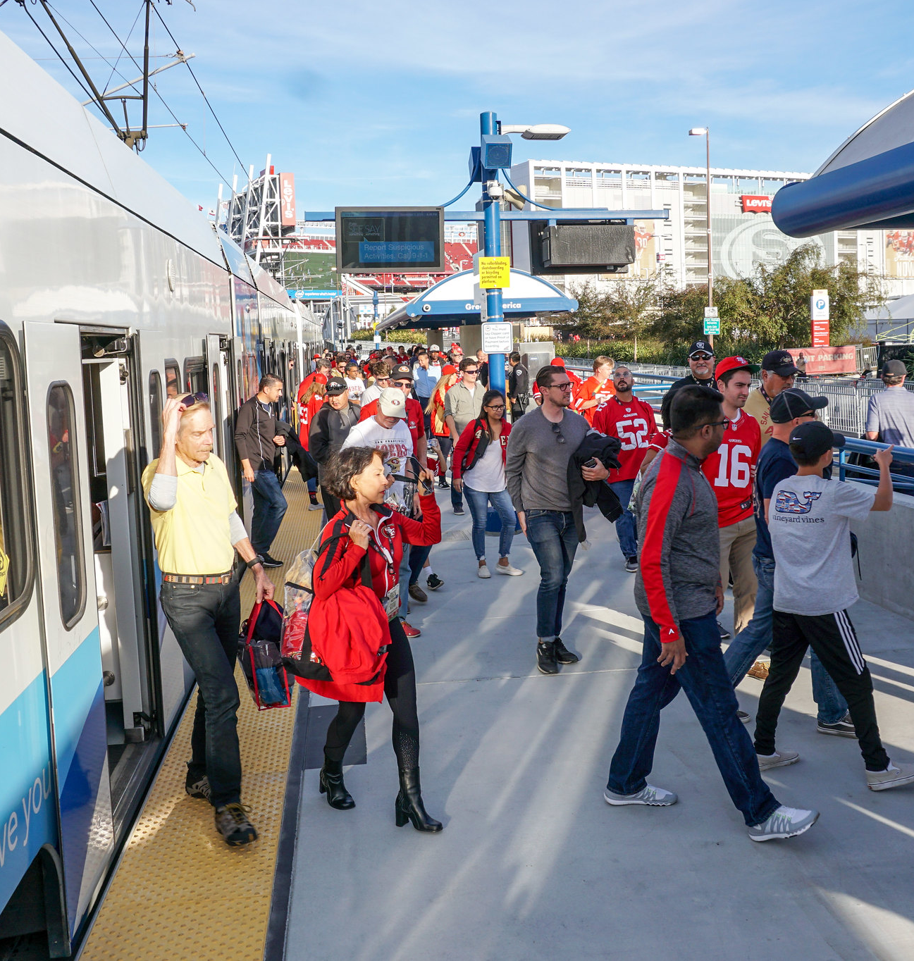
2000 Measure A Sales Tax Program-Operating
Can we make this more appealing. Ie. Picture in background, etc..
Primarily Operating Assistance to
VTA Transit and Debt Service
Operations & Maintenance (O&M) Agreement in force
Proposed Budget:
Category (In millions) | FY24 | FY25
Revenues | $290.63 | $300.24
Expenses | $147.26 | $150.09
Net Revenue/Expense | $143.37 | $150.15
Note: Totals may not be precise due to independent rounding

Slide 26
2000 Measure A Sales Tax Program – Capital
Planning and completion of projects in specific categories as detailed in the 2000 Measure A Ballot
Project | Total (in millions)
BART Phase II | $2,354.7
Eastridge to BART Regional Connector | $61.1
Total | $2,415.8
Note: Totals and percentages may not be precise due to independent rounding

Slide 27
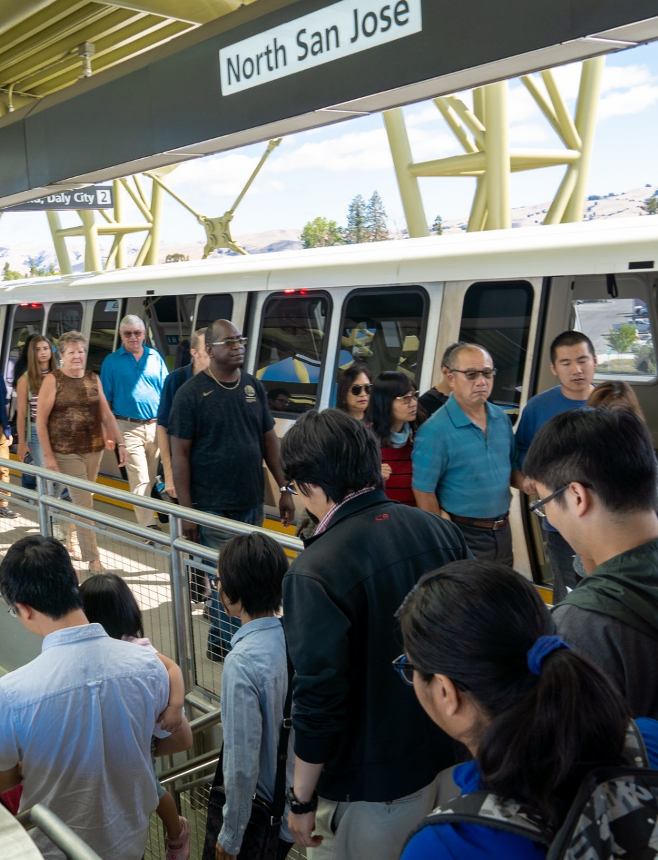
2008 Measure B - BART Operating Sales Tax Program
Dedicated to provide funding for BART Silicon Valley Extension costs:
  Operating
  Maintenance
  Capital Reserve
Operations & Maintenance (O&M) Agreement in force.
Program Expenses:
(in millions) | FY24 | FY25
O&M cost and Contribution to BART Capital Improvement Projects | $102.2 | $99.1
VTA Operating expense | $7.2 | $7.5
VTA Administered Capital Project | $0.8 | ----
Total Expenses | $110.2 | $106.6

Slide 28
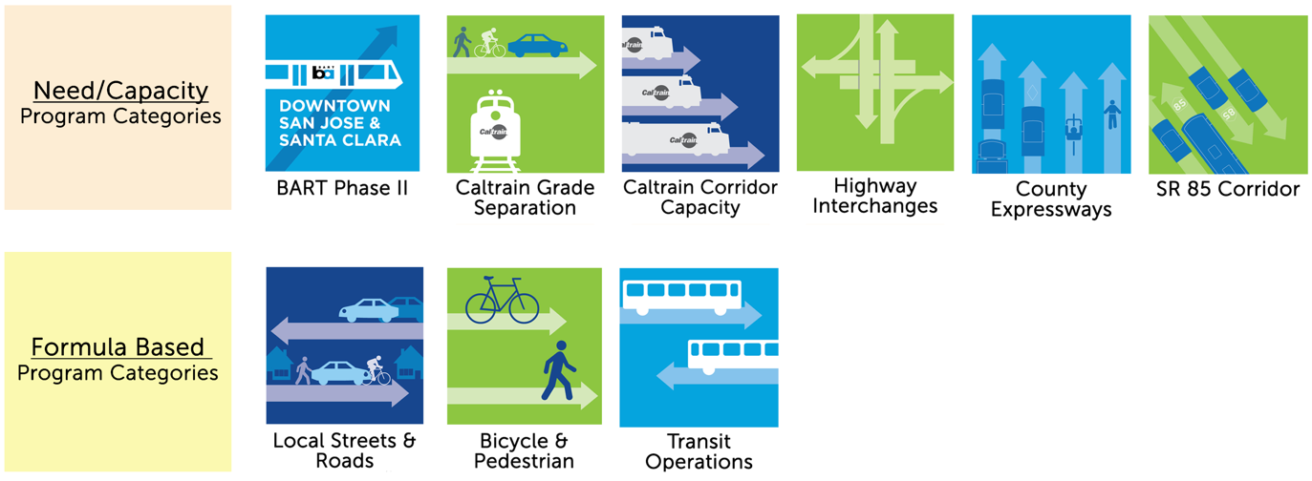
2016 Measure B Sales Tax Program
Program Categories

Slide 29
2016 Measure B Sales Tax Program Budget
 |  | FY2024 | FY2025
Administration |  | $1.50 | $2.00
Program Category
Formula-based Programs
Local Streets & Roads |  | $52.63 | $54.71
Bicycle & Pedestrian |  | $10.23 | $11.40
Transit Operations |  | $17.87 | $22.80
Need/Capacity-based Programs
BART Phase II |  | $575.00
Caltrain Grade Separations |  | $107.00
Caltrain Corridor Capacity Improvements* |  | -
Highway Interchanges |  | $48.36
County Expressways |  | $4.30
SR 85 Corridor* |  | -
TOTAL |  | $907.79
* Previous allocations available and sufficient for FY24/FY25 projected needs

Slide 30
Public and Community Meeting Schedule
Community Meetings
Committee Meetings @ VTA Headquarters
Board Meeting ~ Biennial Budget Adoption
Wednesday, May 24 | 6:00 pm | Video and Teleconference Meeting
Friday, May 26 | 12:00 pm | Video and Teleconference Meeting
Wednesday, May 10 | 1:30 pm | Technical Advisory Committee
Wednesday, May 10 | 4:00 pm | Citizens’ Advisory Committee
Wednesday, May 10 | 6:30 pm | Bicycle & Pedestrian Advisory Committee
Thursday, May 11 | 10:00 pm | Committee for Transportation Mobility & Accessibility
Thursday, May 11 | 4:00 pm | Policy Advisory Committee
Tuesday, May 18 | 12:00 pm | Administration & Finance Committee
Thursday, June 1 | 5:30 pm | County of Santa Clara, Board Chambers

