Slide 1
Doing Business with Santa Clara Valley Transportation Authority (VTA)
Procurement, Contracts and Materials Management Department
May 11, 2017

Slide 2
Organizational Overview
VTA is an independent special district that provides sustainable, accessible, community-focused transportation options that are innovative, environmentally responsible, and promote the vitality of our region.
VTA provides bus, light rail, and paratransit services, and funding partner in regional rail service including Caltrain, Capital Corridor, and the Altamont Corridor Express.
As the County’s Congestion Management Agency, VTA is responsible for:
countywide transportation planning
congestion management
design and construction of specific highway, pedestrian, and bicycle improvement projects
promotion of transit oriented development.
VTA builds partnerships to deliver transportation solutions that meet the evolving mobility needs of Santa Clara County

Slide 3
What does VTA procure and contract for?
Full range of goods, services, supplies and parts. Examples include:
30 Million dollars of inventory with approximately 75,000 parts to support maintenance of buses and light rail
Professional Services Consultants: Engineers, Designers, Architect and others
Construction contracting from small facility maintenance trades such as electrical, HVAC and others to large construction projects
Procurement of Operational goods and services. Everything from office supplies to buses.

Slide 4
Procurement and Contracting Methods
Invitation for Bids (IFB)
Used when a complete, precise and realistic specification or purchase description is available
Sealed bids are publicly opened at a specified time and location
Award is made to the responsible and responsive lowest price bidder
Request for Proposals (RFP)
Used for award to the proposer whose proposal provides the greatest value (Best Value Procurement) to VTA. All
Evaluation factors and their relative importance are specified in the solicitation. A specific method is established and used to
Conduct technical evaluations of the proposals received and to determine the most advantageous offer. An
Award is made to the responsible proposer whose proposal is most advantageous to VTA with price and other factors considered.
Negotiated Procurements (NP/RFP)
Public Contract Code requires the VTA Board of Directors approve the use of the NP process.
NP/RFP is used for contracting whereby the VTA and potential contractor negotiate on both price and technical requirements after submission of proposals.
Award is made to the contractor whose final proposal is most advantageous to the VTA.

Slide 5
Solicitations
VTA IFBs and RFPs are advertised on VTA.org. The basic details of the solicitations can be viewed without registering on the site at the following link:
http://www.vta.org/about-us/procurement

Slide 6
How to Become a Vendor
All contract solicitation information is published on the Procurement website, including all updates
Vendors can register for a specific solicitation
VTA also advertises in the San Jose Mercury News with “Notice to Bidders/Proposers” advertisements
Vendors can call or e-mail requesting a particular IFB or RFP

Slide 7
Vendor Registration Instructions
There are two ways to sign up as a "vendor"; either through an existing solicitation or on our Vendor Registration page. Either way, you just enter your email address in the field provided on the page and click the button.
To sign up as a vendor through an existing solicitation, you may do so at the following link:
http://www.vta.org/about-us/procurement/become-a-vendor
To register as a vendor, the instructions are at the following link:
http://www.vta.org/about-us/procurement/vendor-settings?action=Register

Slide 8
Vendor Registration Instructions (cont’d)
Enter your email address in the field provided on the page and click the button.
If you are already a vendor an email will be sent to the email address we have on file that has verifies the information we have on file and instructions on how to update anything that is outdated.
If you are not in the system you will be asked to submit your vendor information.
Once complete you will be sent an email verifying your information and with a link that you must click to verify and complete the sign up process.
Once registered, you will receive automated notifications of opportunities to bid. You can control the type and frequency of notifications from the vendor settings page.

Slide 9
What happens after registration?
Once you receive notice of bid opportunity, determine if it is of interest to you. Review scope completely.
Call the procurement staff if you have questions on the scope or the business terms.
If you submit a bid that is not successful, call the procurement staff to get feedback. Debrief appointments are provided.
Don’t give up, try again! It is not uncommon for a new vendor to submit several bids on different projects before being successful.

Slide 10
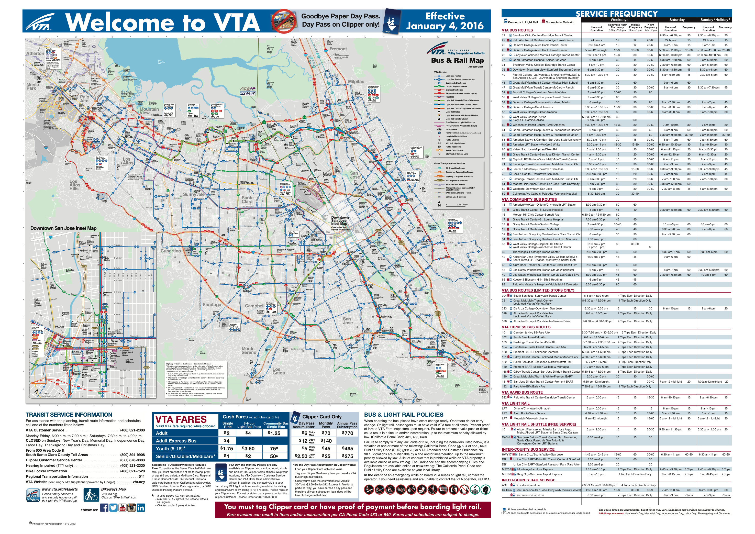
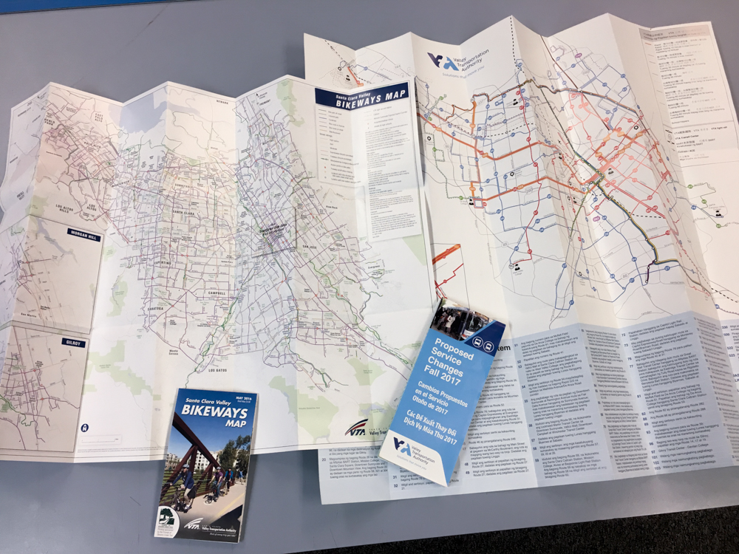
4-Color Printing
Shelter Map 43x29
Folded Brochures

Slide 11
Opportunities
Printers
Janitorial
Office
Landscape
All Construction trades

Slide 12
Questions?

